Slide 1

Welcome to Reeler
Where we reel up the scams
We have realised that with higher reliability on technology and online application there are bound to be certain risks involved. These risks range from hacking to firewall breaching to scams and to using unauthorised computers. As we learn more about these security breaches, the level of complexity of these threats grow. We are here to target one of these threats. Phishing email scams.

Slide 2

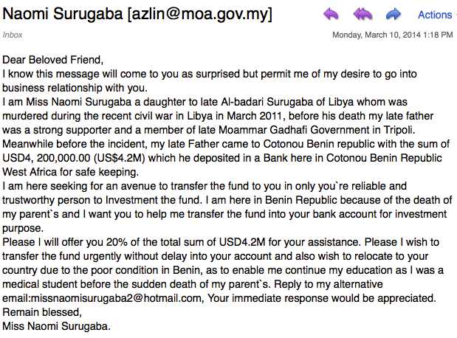
What is a phishing email?
Phishing emails are unwanted emails sent from a malicious person for the purpose of getting sensitive information out of the target, Phishing emails are becoming more concerning due to the ever-growing demand for online communication. Phishing emails are fake emails who pretend to be someone close/important who and try convincing/threating you to give up personal data. An example of a phishing email is on below.
This is a clear example of a false promise used to entice more gullible individuals to contact them on their alternative email so they can ask for private information, pretending to be someone with unfortunate luck.

